Slide 1
Evaluating Gender Bias in BERTić,
a Large Language Model
Trained on South Slavic Data
Aly Butler
Department of Linguistics
University of California, Davis

Slide 2
1. background
fairness in the field of artificial intelligence
characterizing social biases in large language models
2. issues in language modeling
gender agreement in Croatian
3. current work
using English-language measures of bias for Croatian
alternate approach which considers morphological complexity
Presentation Overview

Slide 3
Large Language Models (LLMs)
artificial neural networks
computational models similar to brain
connections between neurons have weights which may be adjusted
LLMs
trained on artificial neural networks and large amounts of text data
state-of-the-art models: BERT, GPT-4, LLaMA
uses: resume filtering, question answering, text prediction, translation
made up of layers of neurons
uses: self-driving cars, face recognition, natural language processing

Slide 4
Training LLMs
LLMs require vast amounts of text for optimization
usually from internet - Wikipedia, Reddit, news, literary corpora
newer ones typically trained to predict words from large context windows
information learned by models:
vocabulary, syntax, semantics
social biases of humans who generated text
fine-tuning stage
training LLM on specific task:
toxicity detection, summarization

Slide 5
Task
COMPAS software developed to predict recidivism rate in offenders
Amazon hiring tool developed to select best job candidates
Bias Problem
Outcome
black offenders more likely to be incorrectly flagged for recidivism than white offenders; white offenders more likely to be incorrectly flagged as low-risk for recidivism
male-identifying applicants more likely to be selected over others for typically male roles regardless of qualifications

Slide 6
LLMs learn social biases and perpetuate them during output
previous research on biases in LLMs:
Bolukbasi et al. (2016)
debiasing type-level models (word2vec, GloVe), maintaining “useful” stereotypes
Kurita et al. (2019)
developing bias measurements for contextualized models (BERT, GPT-4)
Bender et al. (2021)
careful selection of training data, transparency in how LLMs are implemented
Bhatt et al. (2022)
testing biases in LLMs trained on low-resource languages, consideration of non-English/Western geopolitical contexts
AI Fairness

Slide 7
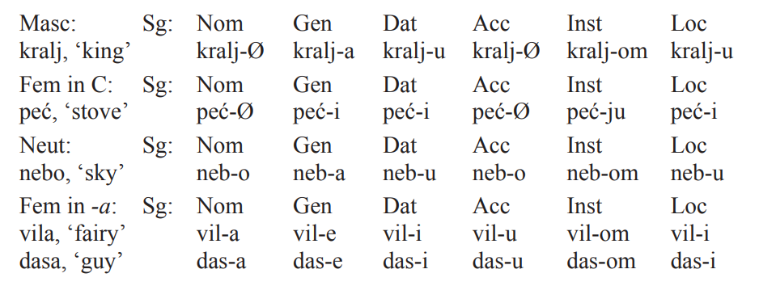
Issues in Language Modeling: Croatian Gender Agreement
(Arsenijević & Borik 2022)

Slide 8
Issues in Language Modeling: Croatian Gender Agreement
a.
b.
c.
(Tomić 2006, Puškar 2017)

Slide 9
Current Work: Questions
How should social biases be quantified in LLMs?
How should these measures differ across models trained on different languages(English vs. Croatian)?

Slide 10
Methods
experiment I
quantify gender bias in BERT and mBERT for English using the template-based approach (Kurita et al., 2019)
(1) “[MASK] is a progammer.” MASK = he, she
experiment II
quantify gender bias in mBERT and BERTić for Croatian using the same approach
(2) *Ona je programer.
she.NOM COP programmer.NOM.M
experiment III (to be completed)
adjust the test to quantify gender bias in mBERT and BERTić for Croatian
(3) Ona se bavi programir-anjem.
she.NOM refl deal.PRES programming-INS
“She works in programming.”

Slide 11
Experiment I: BERT and mBERT (En)
male | female | career | family
he | she | lawyer | family
John | Anne | salary | parents
Paul | Lisa | doctor | children
Mike | Sarah | business | cousins
Kevin | Diana | management | marriage
Steve | Amy | programmer | relatives
Template sentences where target = male/female words, attribute = career/family words
(4) a. TARGET is interested in ATTRIBUTE
b. TARGET likes ATTRIBUTE
c. TARGET is a ATTRIBUTE

Slide 12
Experiment II: mBERT and BERTić (Cro)
male | female | career | family
on <he> | ona <she> | odvjetnik <lawyer> | dom <home>
brat <brother> | sestra <sister> | plaća <salary> | brak <marriage>
otac <father> | majka <mother> | doktor <doctor> | obitelj <family>
tata <dad> | mama <mom> | medicina <medicine> | porodica <family>
sin <son> | žena <wife/woman> | šef <boss> | kuća <house>
Template sentences where target = male/female words, attribute = career/family words
(5) a. TARGET se zanima za ATTRIBUTE
refl interest.PRES in
TARGET is interested in ATTRIBUTE
b. TARGET voli ATTRIBUTE
like.PRES
TARGET likes ATTRIBUTE
c. TARGET je ATTRIBUTE
COP
TARGET is a ATTRIBUTE

Slide 13
Hypothesis
If the tests are suitable measures of bias, all three models will reveal gender bias for both English and Croatian.

Slide 14
Preliminary Results and Analysis
permutation tests used to calculate difference in means between each LLM predicting either female or male related words in a given template sentence
significant at p < 0.01
 | BERT | mBERT | BERTić
En | 0.003 | 0.0003 | --
Cro | -- | 0.48 | 0.13
p-values from permutation tests
gender bias found in BERT and mBERT for English
gender bias not found in mBERT and BERTić for Croatian

Slide 15
Limitations
BERTić model is small (8 billion tokens); mBERT is trained on little South Slavic data
different template sentences and word lists may yield different results
this project looks at gender stereotypes related to career and family
some evidence suggests the approach is too sensitive to specific words rather than the meaning of the whole sentence (Kwon & Mihindukulasooriya, 2022)

Slide 16
Next Steps
run experiment III
adjust template sentences to account for gender in Croatian
paraphrase sentences as suggested in Kwon & Mihindukulasooriya (2022)
consider other types of biases in same context
ethnic, religious, linguistic, socioeconomic etc.

